Slide 1
Community Award
Parent Guide

Slide 2
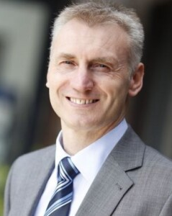
Foreword from Mark Farmer, CEO
I am extremely excited about the launch of our new, trust-wide Community Award programme. Community is at the heart of what Bridge Academy Trust stands for and we have achieved so much within and across our schools through collaboration, networking and sharing best practice and resources. All to raise standards for our children and families and to support our staff.
What has been very clear to me since the formulation of our trust is that our children (& adults) are involved in some truly wonderful things outside of school. We now want to recognise and celebrate the children’s community work, and to encourage and promote more children to get involved in community activities and projects too, and, at the same time, to see what more our local communities can do to support our schools and children too. Our Local Governing Committees are working on this and much more.
Please read through what our new award is all about and help us to promote this and to celebrate the fantastic community work that our children are involved in.
Mark Farmer
CEO

Slide 3
What is the Bridge Academy Community Award?
This is recognition award to encourage all our pupils across all our schools to get involved in their local communities by completing community spirited tasks.
Your child’s school will provide a list of tasks to be completed, but we’d also love to hear about other community spirited things that they have been involved in outside of school.
There are 2 stages per year group that will take place over the course of the academic year, with 6 different tasks in each stage.
Children will be awarded a badge for each stage successfully completed.
For those children who go above and beyond, there is the opportunity to be nominated for a silver badge and goody bag and one pupil per school will also go on to receive a gold badge and £100 towards a community project of their choice.

Slide 4
















Each Year group will have its own set of badges to allow for the award to follow the child through their school life
Badges will be the colours of the rainbow to inspire children to collect all 7 colours throughout their primary school life
There will be 2 stages to complete each academic year
For those who go above and beyond there is the chance to be nominated for silver badge plus a goody bag, with one silver award availble per class.
One child per school will receive a gold badge and £100 towards a community project of their choice

Slide 5
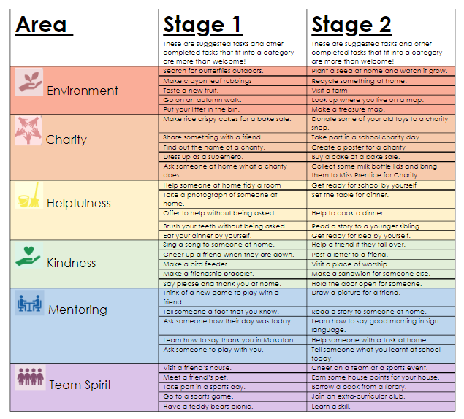
Completing Tasks for Each Stage
Here is an example of the task list. There is one per year group with tasks for each area and stage. Children need to complete one per area to achieve their stage.
This is guide for tasks that can be completed in order to achieve the award. However, if children have other ideas that fit into an area, they are more than welcome to complete and document these as part of their journey.

Slide 6
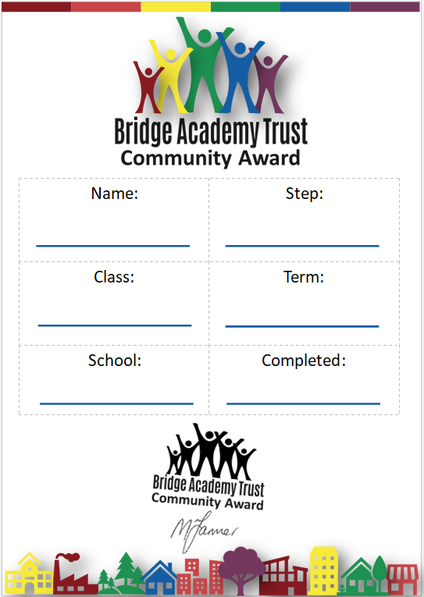
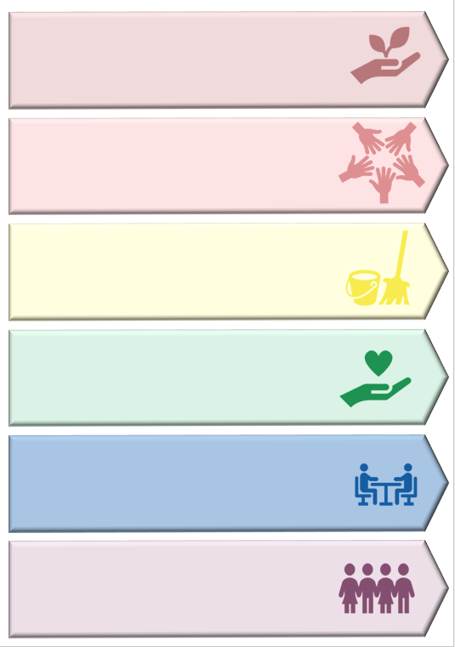
Documenting tasks for each primary stage
Tasks will be set in categories. these categories are, but not limited to:
  Environment
  Charity
  Helpfulness
  Kindness
  Mentoring
  Team spirit
  We ask parents to support their child in their activities, but allow their child to complete the tasks as independently as possible. Please upload any evidence to Tapestry with the #communityaward and Miss Prentice will be able to access this each Friday Lunch time for children to have their tasks signed off. Children can also bring evidence on day.
  Tasks will be signed off and documented using the postcards so please keep them safe!

Slide 7
How you can help at home
Support your child to complete activities, but allow them to be completed as independently as possible.
Tell us about anything that your child is doing/ has done that is community minded, regardless of whether it is on their task list. All activities can go towards an award. For example:
  Helping at home
  An act of kindness
  Supporting others
  Club involvement
Encourage your child to get involved with community projects and clubs
Talk to your child about the communities around them and that they are involved in
Let us know if know if there are any community programmes that we can get involved in as a school or trust and if you have something you'd like to come in and talk about in assembly, please get in touch with Miss Prentice!

